Slide 1



ML/DL for Everyone with
Lecture 10: Basic CNN
Sung Kim <hunkim+ml@gmail.com> HKUST
Code: https://github.com/hunkim/PyTorchZeroToAll
Slides: http://bit.ly/PyTorchZeroAll
Videos: http://bit.ly/PyTorchVideo

Slide 2

Call for Comments
Please feel free to add comments directly on these slides.
Other slides: http://bit.ly/PyTorchZeroAll
Picture from http://www.tssablog.org/archives/3280

Slide 3
ML/DL for Everyone with
Lecture 10: Basic CNN
Sung Kim <hunkim+ml@gmail.com> HKUST
Code: https://github.com/hunkim/PyTorchZeroToAll
Slides: http://bit.ly/PyTorchZeroAll
Videos: http://bit.ly/PyTorchVideo

Slide 4

CNN
http://parse.ele.tue.nl/cluster/2/CNNArchitecture.jpg

Slide 5
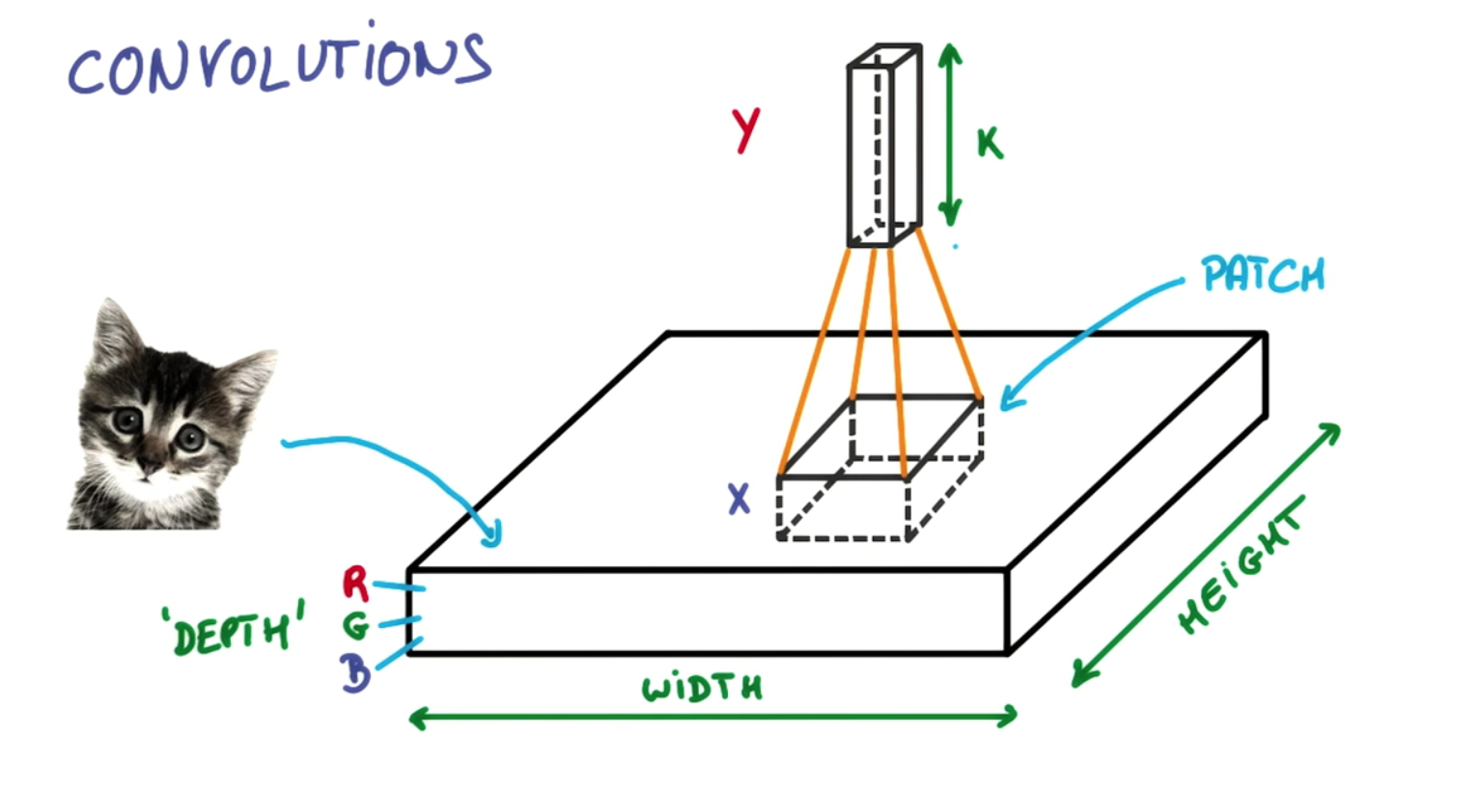
https://ireneli.eu/2016/02/03/deep-learning-05-talk-about-convolutional-neural-network%EF%BC%88cnn%EF%BC%89/

Slide 6
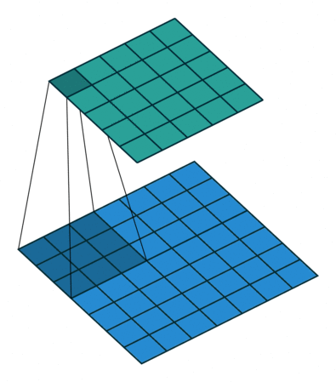
Convolution in Action
https://github.com/vdumoulin/conv_arithmetic

Slide 7
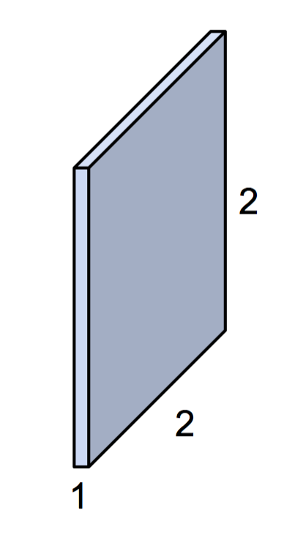
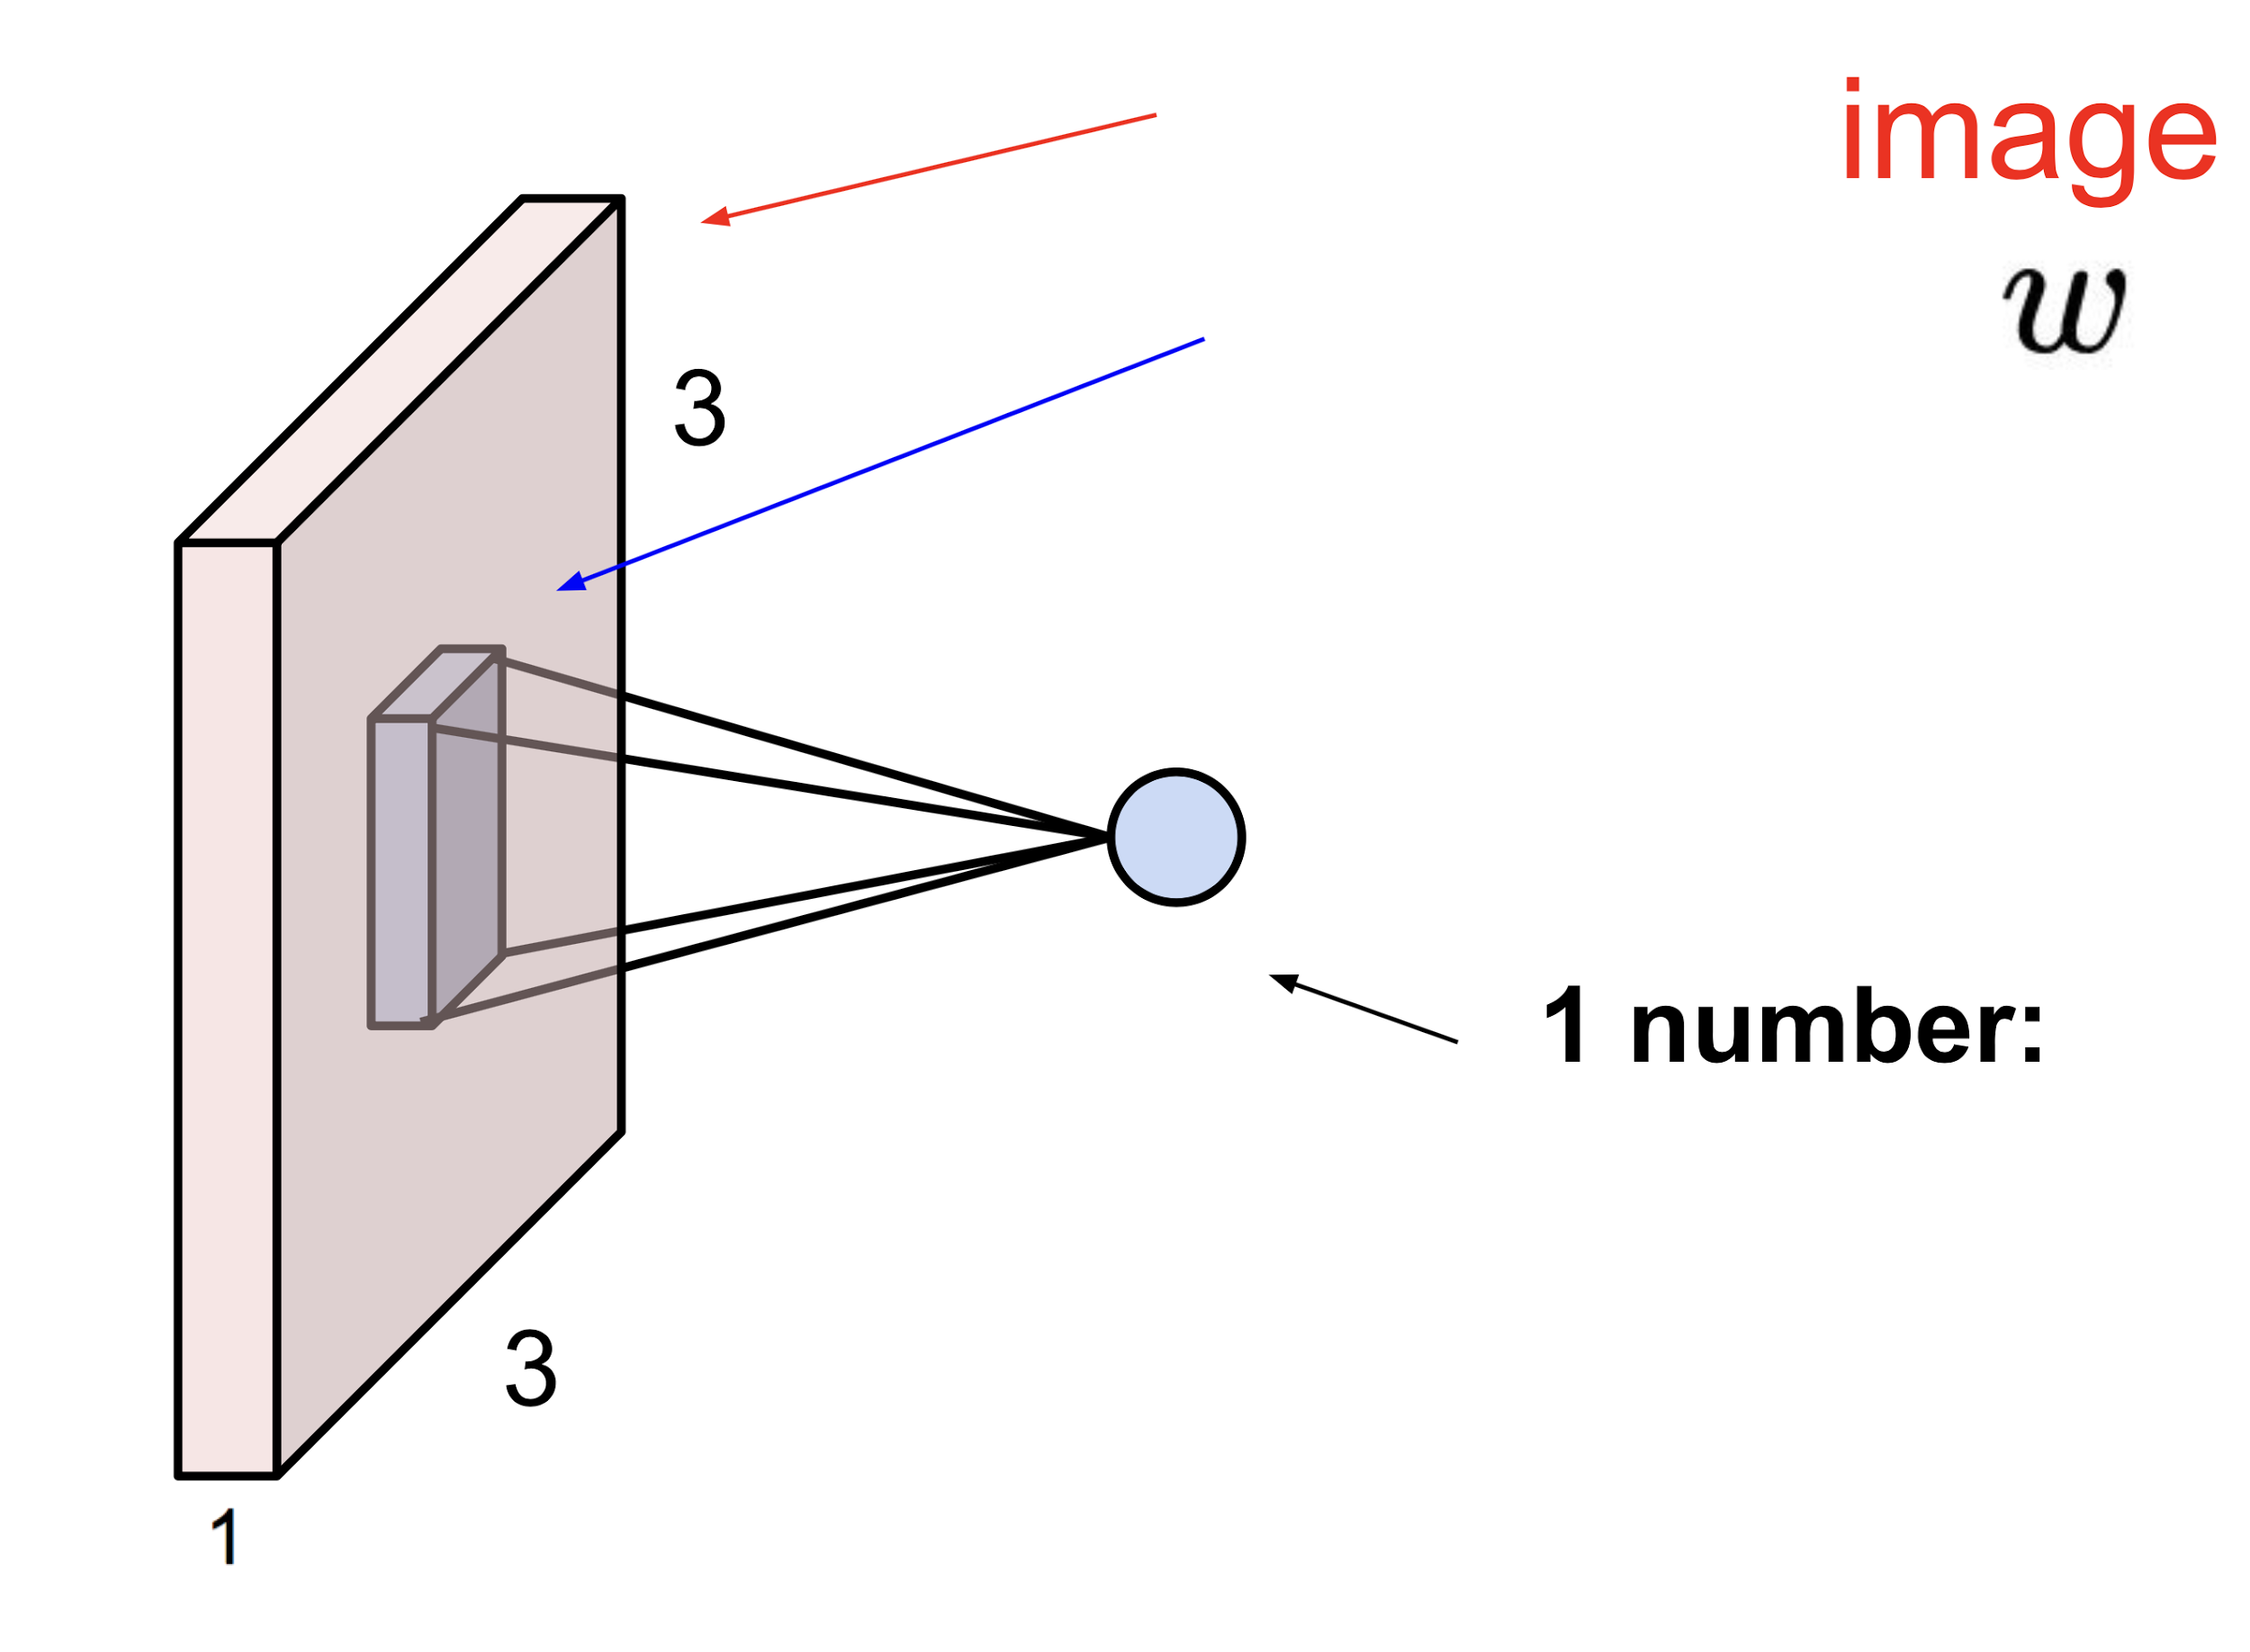
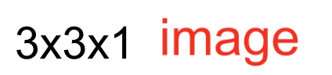
Simple convolution layer
Stride: 1x1
3x3x1
2x2x1 filter

Slide 8
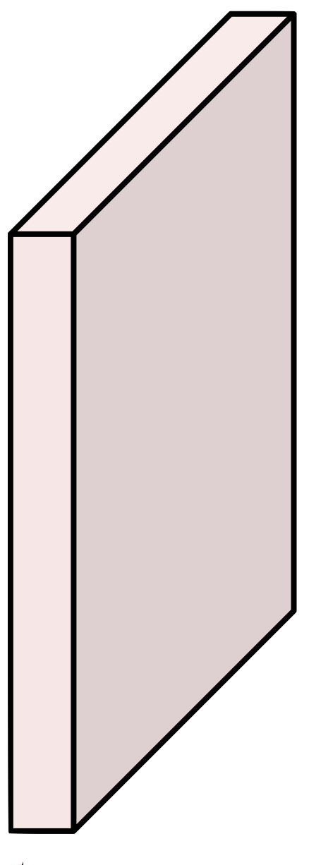
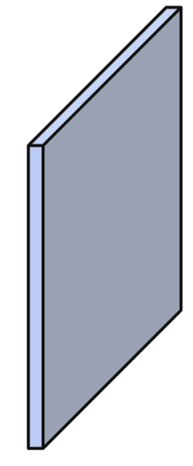
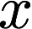
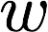
Simple convolution layer
Image: 1,3,3,1 image, Filter: 2,2,1,1, Stride: 1x1, No Padding
3
2
1
6
0.5
5
0.1
4
9
0.4
8
0.3
7

Slide 9
Simple convolution layer
Image: 1,3,3,1 image, Filter: 2,2,1,1, Stride: 1x1, No Padding
3
2
1
6
0.5
5
0.1
4
9
0.4
8
0.3
7

Slide 10
Simple convolution layer
Image: 1,3,3,1 image, Filter: 2,2,1,1, Stride: 1x1, With padding
0
3
2
1
0
6
0.5
5
0.1
3
4
0
9
0.4
8
0
0.3
7
0
3
0
0

Slide 11
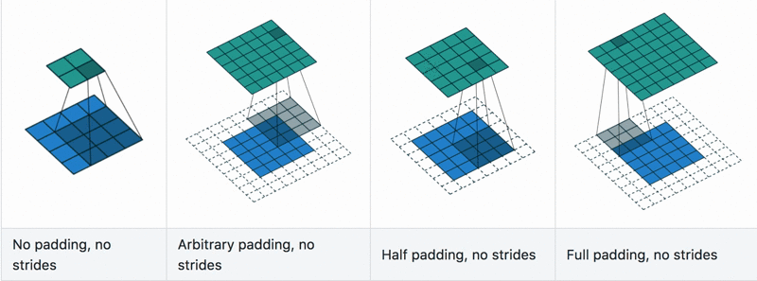
Convolution with padding in Action
https://github.com/vdumoulin/conv_arithmetic

Slide 12
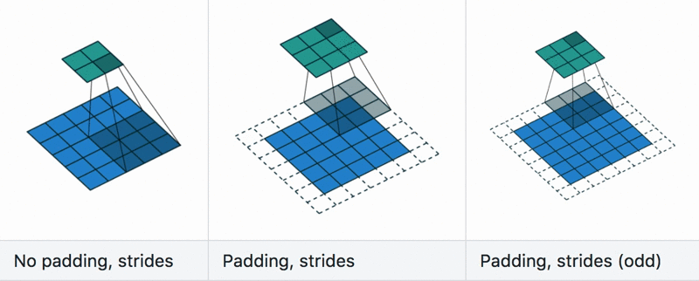
Convolution with stride in Action
https://github.com/vdumoulin/conv_arithmetic

Slide 13
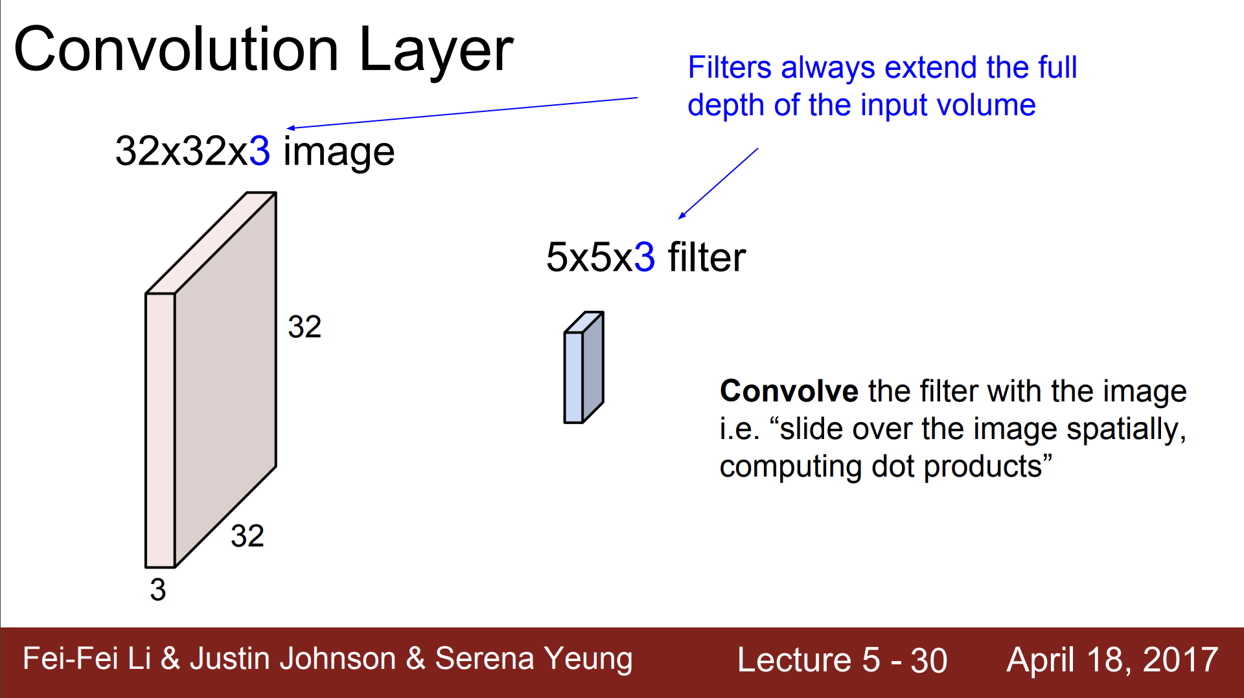

Slide 14
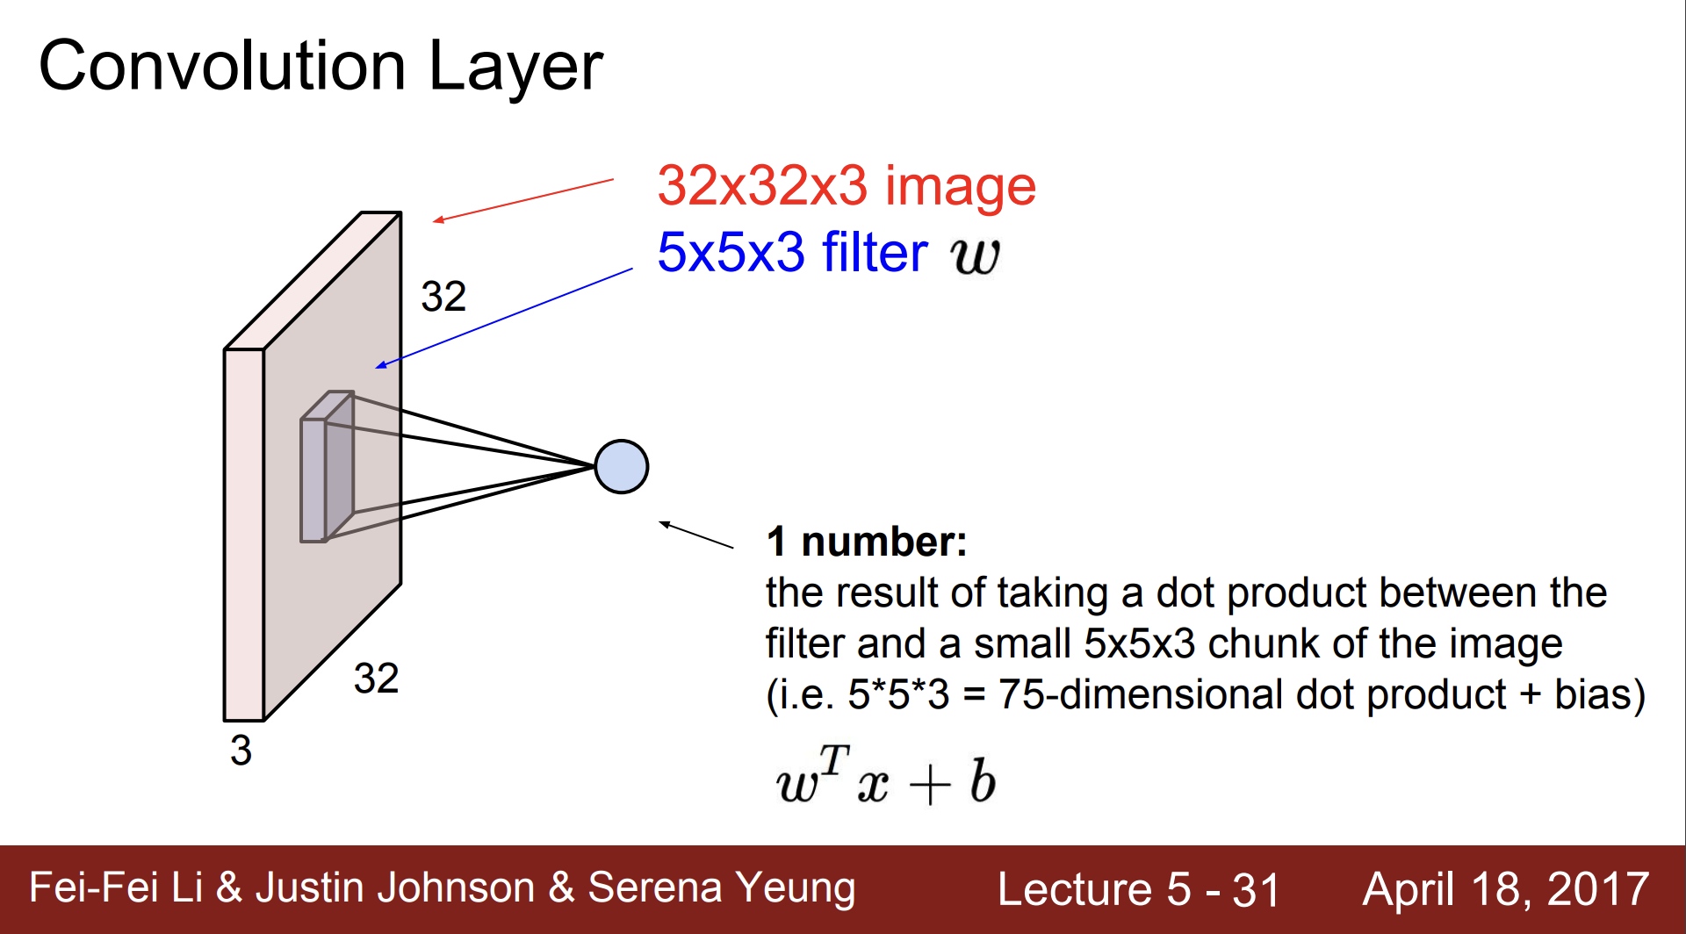

Slide 15
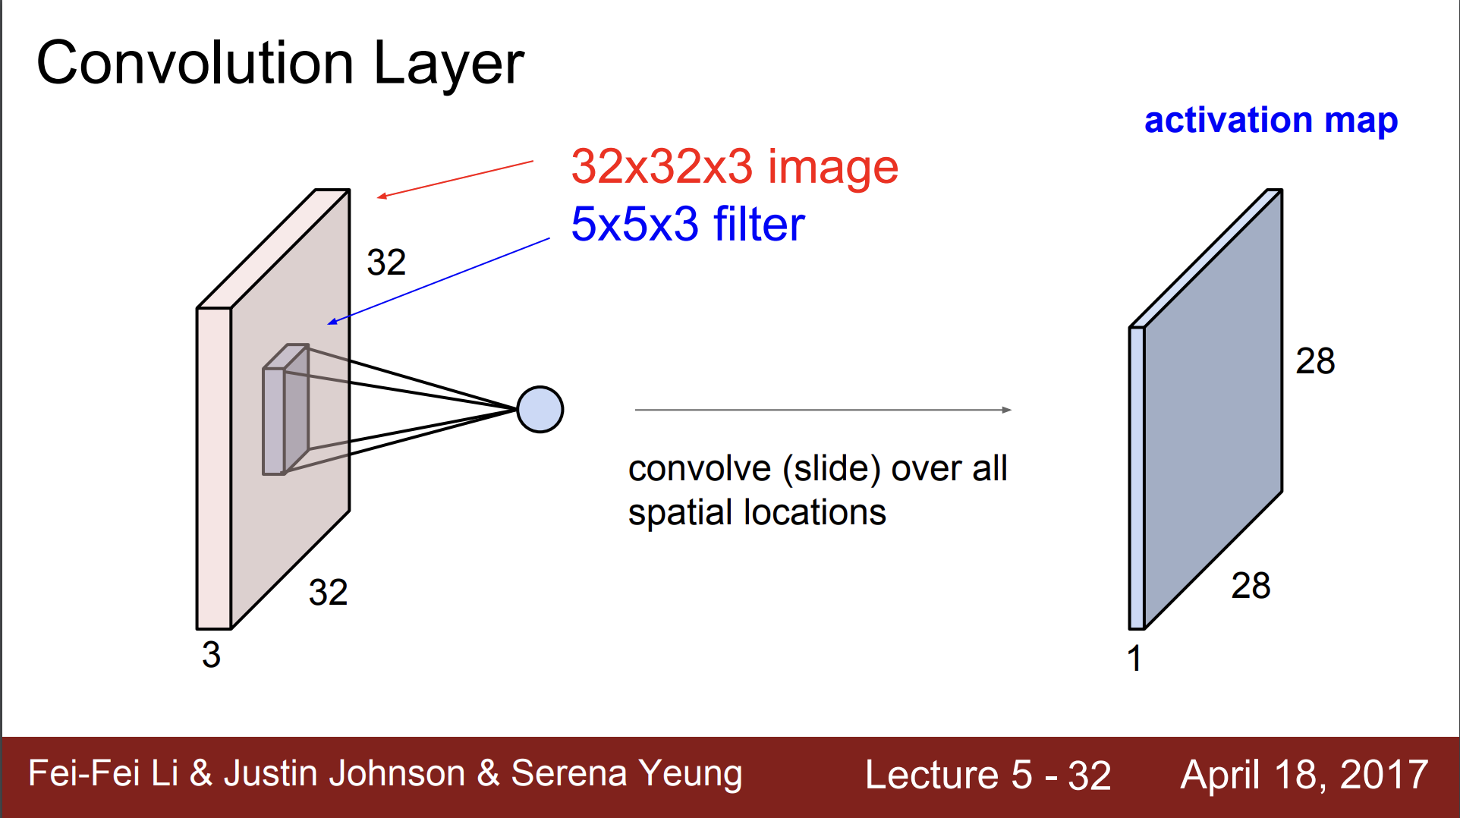

Slide 16
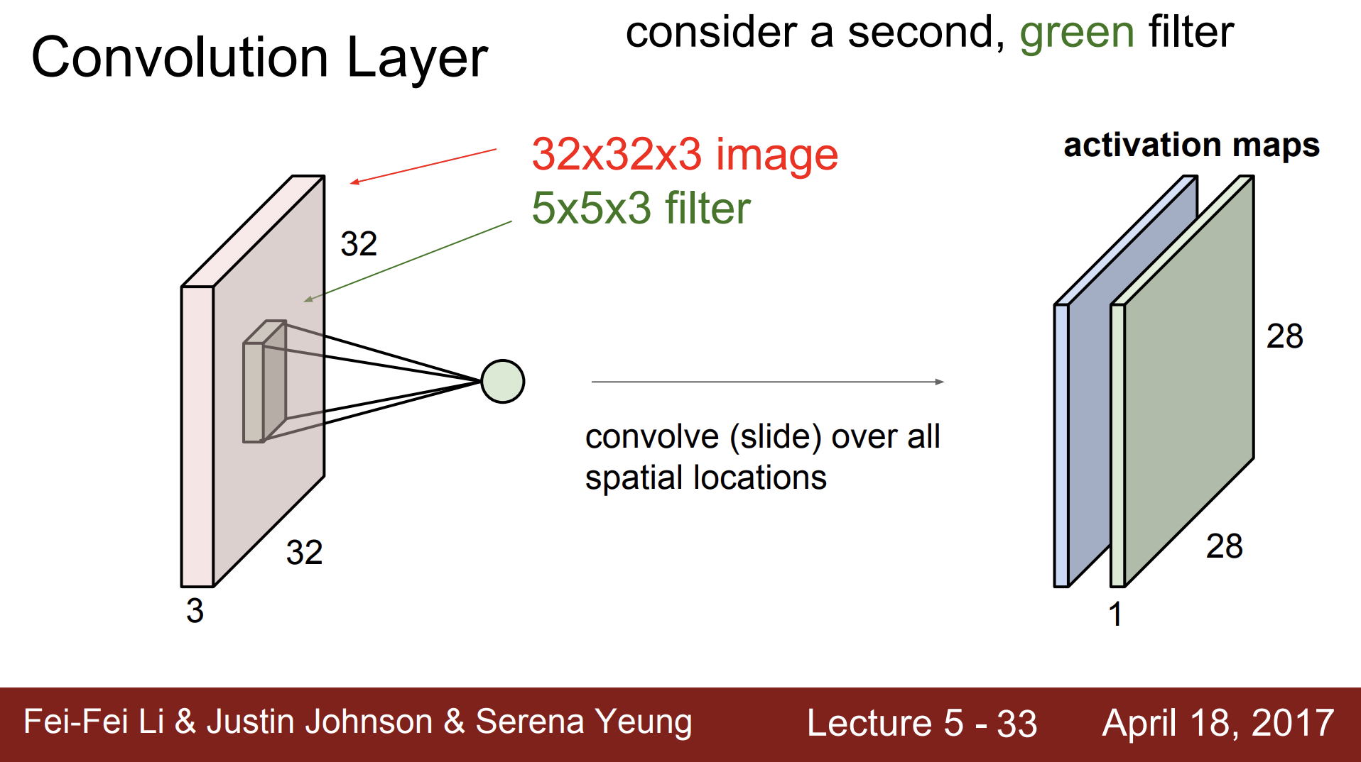

Slide 17
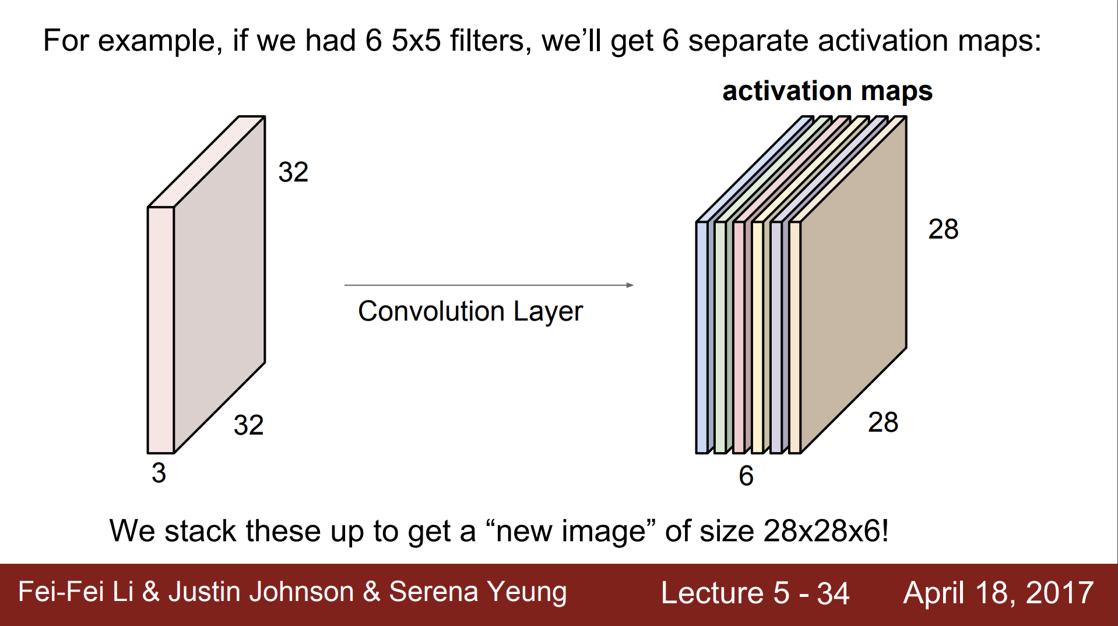

Slide 18
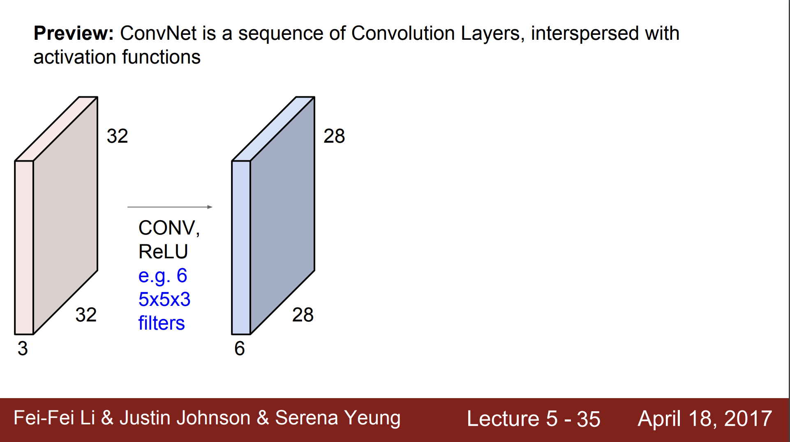

Slide 19
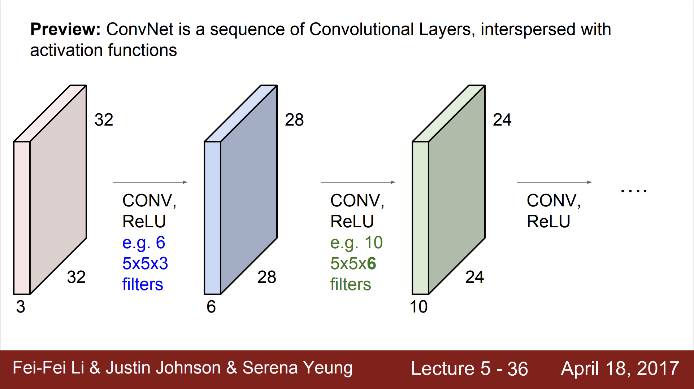

Slide 20
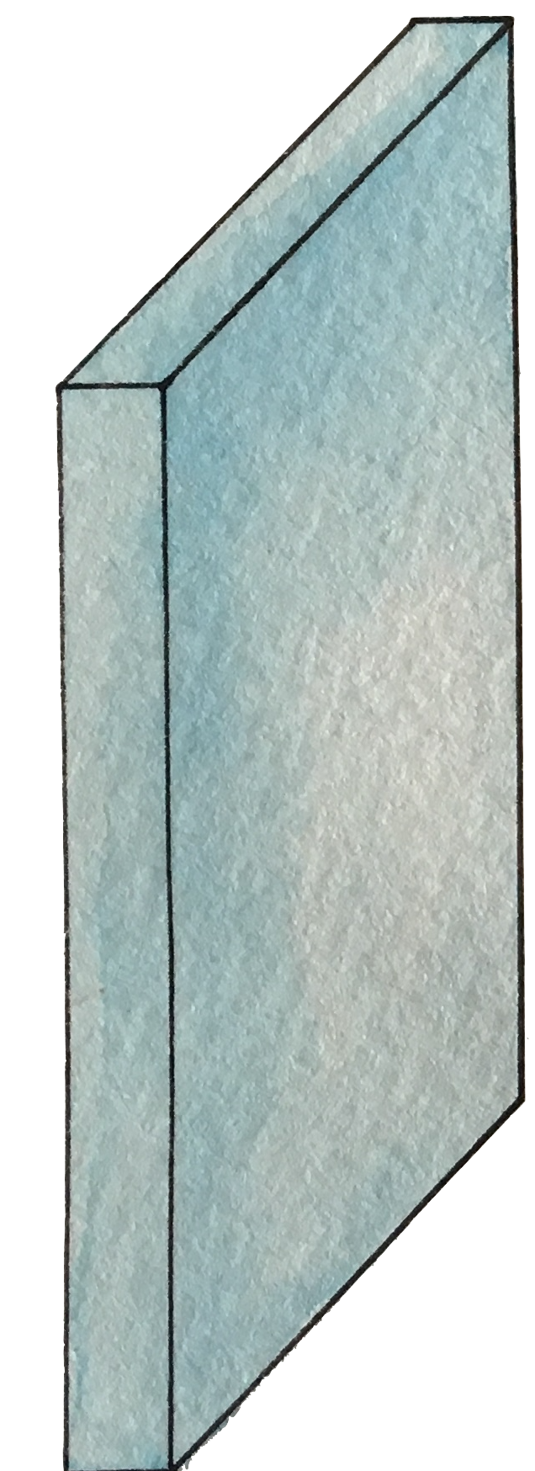
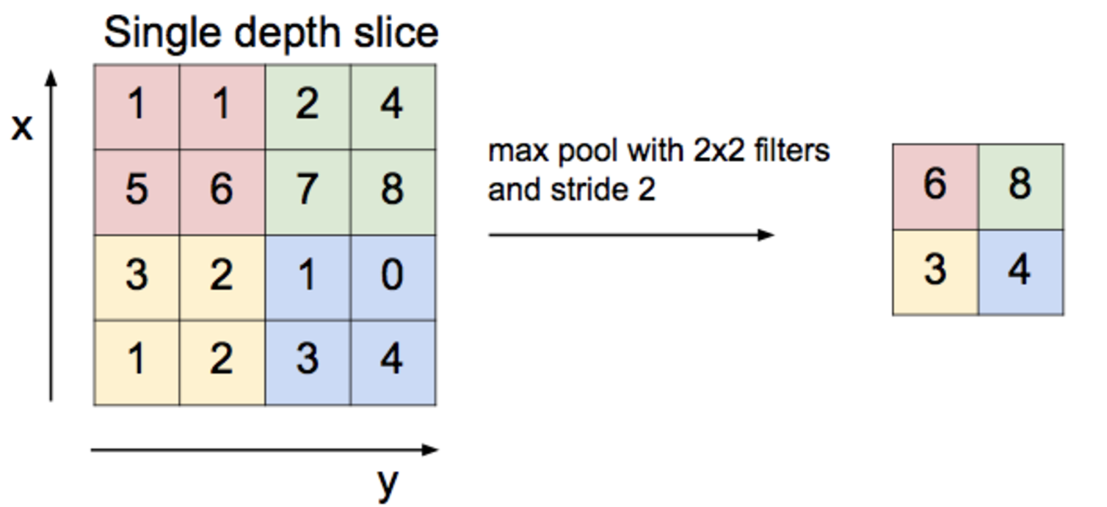
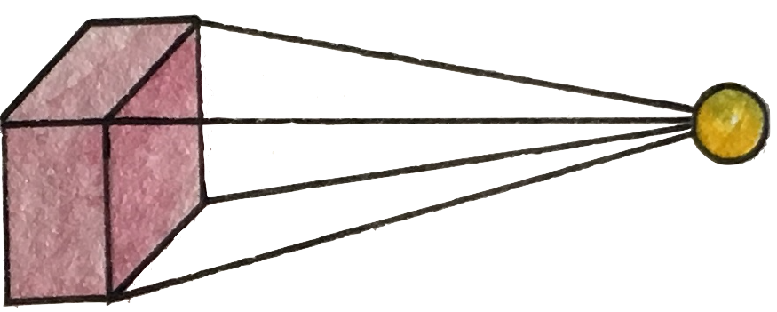
Max pooling

Slide 21
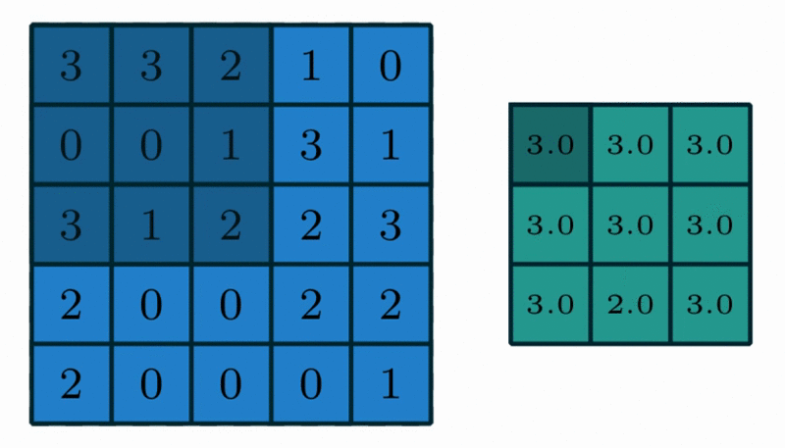
Max Pooling in Action
https://github.com/vdumoulin/conv_arithmetic

Slide 22
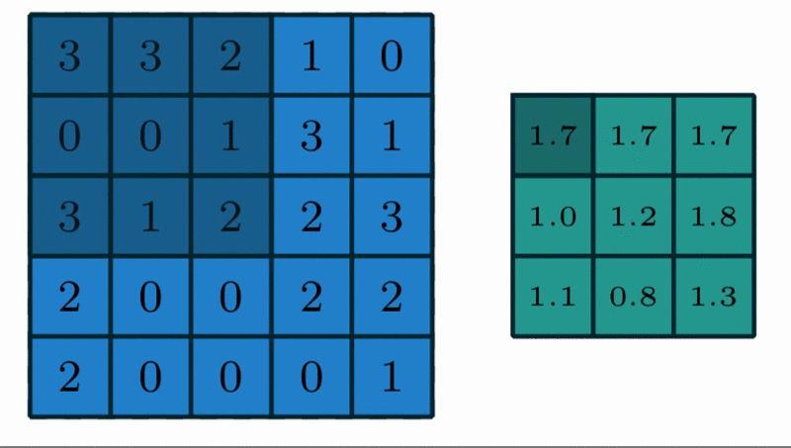
Avg Pooling in Action
https://github.com/vdumoulin/conv_arithmetic

Slide 23
CNN
http://parse.ele.tue.nl/cluster/2/CNNArchitecture.jpg

Slide 24
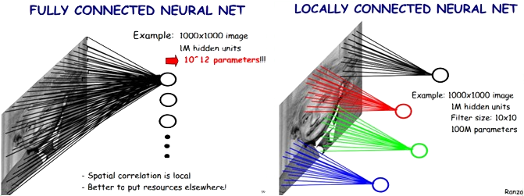
Locally Connected Features
https://ireneli.eu/2016/02/03/deep-learning-05-talk-about-convolutional-neural-network%EF%BC%88cnn%EF%BC%89/

Slide 25
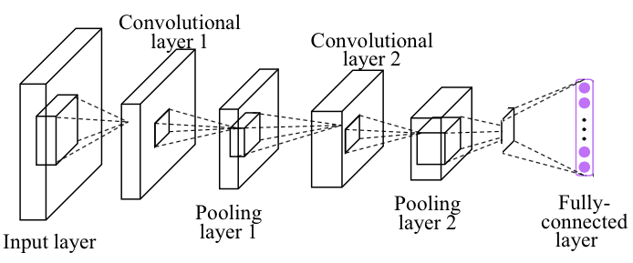
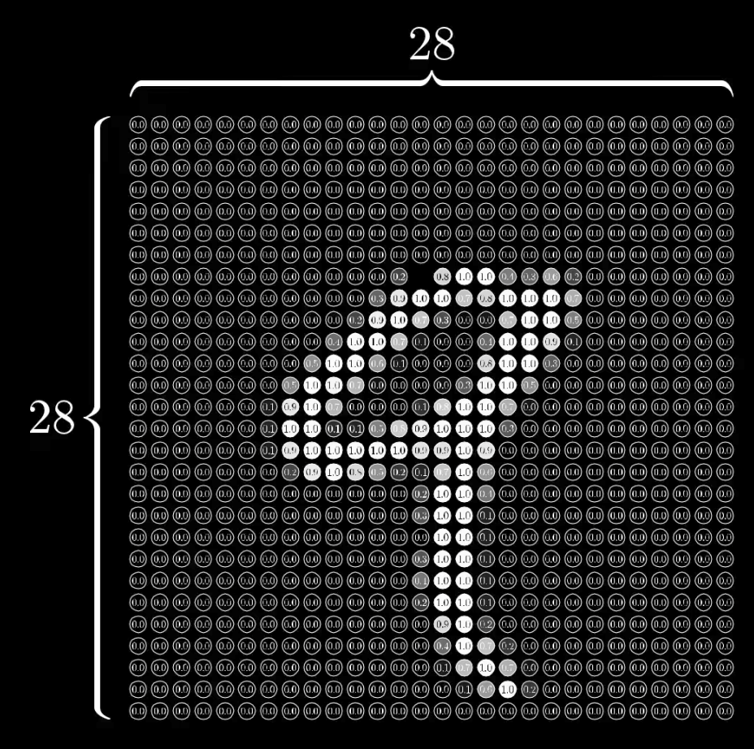
Simple CNN

Slide 26
Simple CNN
self.fc = nn.Linear(320, 10)
Linear
nn.MaxPool2d
(kernel_size)
torch.nn.Conv2d (in_channels,
out_channels,
kernel_siz)
self.mp = nn.MaxPool2d(2)
self.conv1 = nn.Conv2d(1, 10, kernel_size=5)

Slide 27

Simple CNN
class Net(nn.Module):
def __init__(self):
super(Net, self).__init__()
self.conv1 = nn.Conv2d(1, 10, kernel_size=5)
self.conv2 = nn.Conv2d(10, 20, kernel_size=5)
self.mp = nn.MaxPool2d(2)
self.fc = nn.Linear(100???, 10) # ??? -> 10
def forward(self, x):
in_size = x.size(0)
x = F.relu(self.mp(self.conv1(x)))
x = F.relu(self.mp(self.conv2(x)))
x = x.view(in_size, -1) # flatten the tensor
x = self.fc(x)
return F.log_softmax(x)
Notes:
\hat{y}=x*w+b
loss = \frac{1}{N}\sum_{n=1}^{N} y^{(n)} \log \hat{y}^{(n)} + (1 - y^{(n)}) \log (1-\hat{y}^{(n})

Slide 28
Simple CNN
class Net(nn.Module):
def __init__(self):
super(Net, self).__init__()
self.conv1 = nn.Conv2d(1, 10, kernel_size=5)
self.conv2 = nn.Conv2d(10, 20, kernel_size=5)
self.mp = nn.MaxPool2d(2)
self.fc = nn.Linear(100???, 10) # ??? -> 10
def forward(self, x):
in_size = x.size(0)
x = F.relu(self.mp(self.conv1(x)))
x = F.relu(self.mp(self.conv2(x)))
x = x.view(in_size, -1) # flatten the tensor
x = self.fc(x)
return F.log_softmax(x)
RuntimeError: size mismatch, m1: [64 x 320], m2: [100 x 10]
Notes:
\hat{y}=x*w+b
loss = \frac{1}{N}\sum_{n=1}^{N} y^{(n)} \log \hat{y}^{(n)} + (1 - y^{(n)}) \log (1-\hat{y}^{(n})

Slide 29
Simple CNN
class Net(nn.Module):
def __init__(self):
super(Net, self).__init__()
self.conv1 = nn.Conv2d(1, 10, kernel_size=5)
self.conv2 = nn.Conv2d(10, 20, kernel_size=5)
self.mp = nn.MaxPool2d(2)
self.fc = nn.Linear(320, 10) # 320 -> 10
def forward(self, x):
in_size = x.size(0)
x = F.relu(self.mp(self.conv1(x)))
x = F.relu(self.mp(self.conv2(x)))
x = x.view(in_size, -1) # flatten the tensor
x = self.fc(x)
return F.log_softmax(x)
RuntimeError: size mismatch, m1: [64 x 320], m2: [100 x 10]
Notes:
\hat{y}=x*w+b
loss = \frac{1}{N}\sum_{n=1}^{N} y^{(n)} \log \hat{y}^{(n)} + (1 - y^{(n)}) \log (1-\hat{y}^{(n})

Slide 30
Simple CNN
class Net(nn.Module):
def __init__(self):
super(Net, self).__init__()
self.conv1 = nn.Conv2d(1, 10, kernel_size=5)
self.conv2 = nn.Conv2d(10, 20, kernel_size=5)
self.mp = nn.MaxPool2d(2)
self.fc = nn.Linear(320, 10) # 320 -> 10
def forward(self, x):
in_size = x.size(0)
x = F.relu(self.mp(self.conv1(x)))
x = F.relu(self.mp(self.conv2(x)))
x = x.view(in_size, -1) # flatten the tensor
x = self.fc(x)
return F.log_softmax(x)
Train Epoch: 9 [46080/60000 (77%)] Loss: 0.108415
Train Epoch: 9 [46720/60000 (78%)] Loss: 0.140700
Train Epoch: 9 [47360/60000 (79%)] Loss: 0.090830
Train Epoch: 9 [48000/60000 (80%)] Loss: 0.031640
Train Epoch: 9 [48640/60000 (81%)] Loss: 0.014934
Train Epoch: 9 [49280/60000 (82%)] Loss: 0.090210
Train Epoch: 9 [49920/60000 (83%)] Loss: 0.074975
Train Epoch: 9 [50560/60000 (84%)] Loss: 0.058671
Train Epoch: 9 [51200/60000 (85%)] Loss: 0.023464
Train Epoch: 9 [51840/60000 (86%)] Loss: 0.018025
Train Epoch: 9 [52480/60000 (87%)] Loss: 0.098865
Train Epoch: 9 [53120/60000 (88%)] Loss: 0.013985
Train Epoch: 9 [53760/60000 (90%)] Loss: 0.070476
Train Epoch: 9 [54400/60000 (91%)] Loss: 0.065411
Train Epoch: 9 [55040/60000 (92%)] Loss: 0.028783
Train Epoch: 9 [55680/60000 (93%)] Loss: 0.008333
Train Epoch: 9 [56320/60000 (94%)] Loss: 0.020412
Train Epoch: 9 [56960/60000 (95%)] Loss: 0.036749
Train Epoch: 9 [57600/60000 (96%)] Loss: 0.163087
Train Epoch: 9 [58240/60000 (97%)] Loss: 0.117539
Train Epoch: 9 [58880/60000 (98%)] Loss: 0.032256
Train Epoch: 9 [59520/60000 (99%)] Loss: 0.026360
Test set: Average loss: 0.0483, Accuracy: 9846/10000 (98%)
Notes:
\hat{y}=x*w+b
loss = \frac{1}{N}\sum_{n=1}^{N} y^{(n)} \log \hat{y}^{(n)} + (1 - y^{(n)}) \log (1-\hat{y}^{(n})

Slide 31
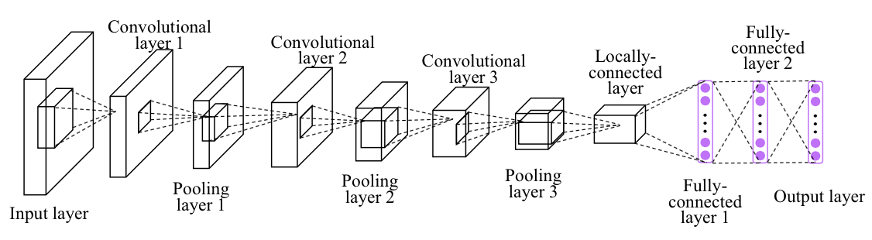
Exercise 10-1: Implement CNN more layers

Slide 32


Lecture 11:
Advanced CNN

